Slide 1
Monocular Estimation of
Spatial Displacement
Notes:
Good evening everyone, I am Helio Perroni Filho and this is my presentation on monocular estimation of spatial displacements.

Slide 2
Profile
2004: Bachelor in Computer Science, UFES
2004: Software developer at Mogai
2008: Software Engineer at LG Electronics
2010: Master in Computer Intelligence, UFES
2013 (Apr): Admitted to Brazilian scholarship program “Ciencia sem Fonteiras” (“Science without Borders”)
2013 (Oct): Started PhD course, University of Tsukuba
Present: Working on thesis project, applications of Weightless Neural Networks to robot localization problems
Notes:
First a little about me.
In 2004 I graduated from the Computer Science course of the Federal University of Espirito Santo, in Brazil. At that year I was also contracted as full-time software developer by Mogai Tecnologia de Informacao, which did software development work for large industries in the Vale do Rio Doce region.
In 2007 I went back to UFES for a Master course on Computer Intelligence. I completed the course in 2010; by that time I had already moved on to LG Electronics, where I worked at the mobile software development division.
In 2013 I was admitted to the Brazilian government's “Science without Borders” program, which allowed me to start my doctorate course at the Robotics Laboratory here in Tsukuba, in October last year.
Currently I am working under Prof. Ohya in applying Weightless Neuron Networks to problems of environment recognition and localization for mobile robots.

Slide 3
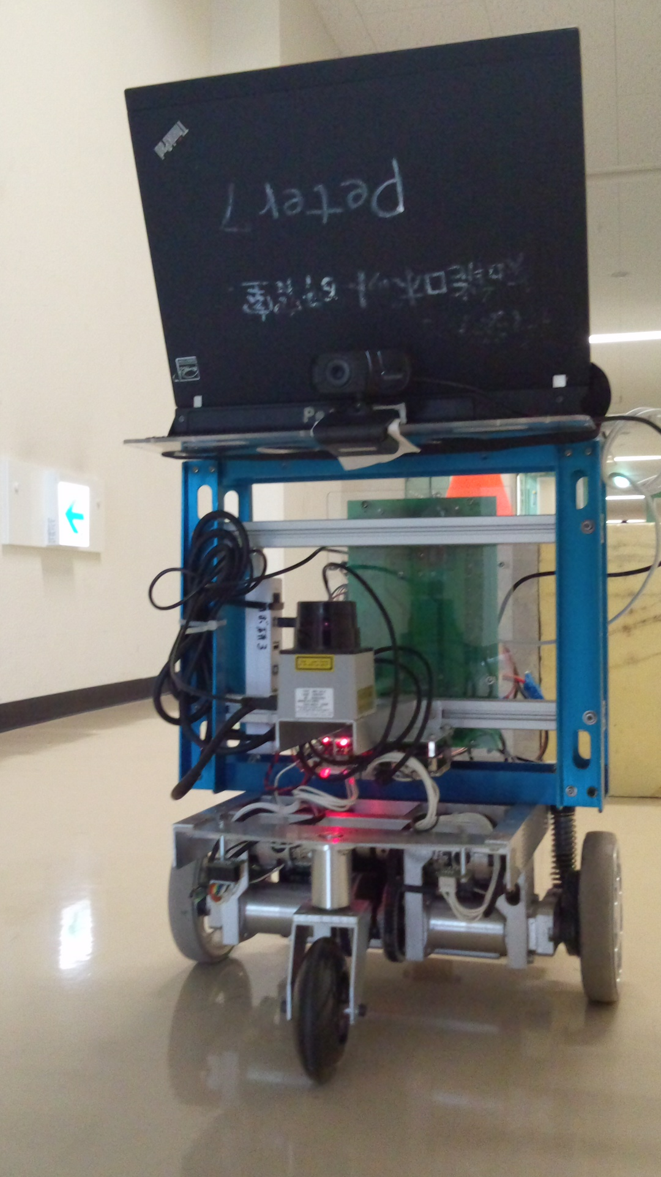
Monocular Displacement Estimation
Robot equipped with monocular camera and odometer
Notes:
Let's consider a mobile robot with a single, front-mounted camera, such as this Yamabiko unit.

Slide 4
Monocular Displacement Estimation
L1 = (x, y, θ)
(Image)
I1
P1
=
Lc = ?
(Image)
Ic
Pc
=
P1
(Δx, Δy, Δθ)
I1
-
Ic
WNN
(Δx, Δy, Δθ)
Pc
Notes:
For example, given a reference image of a destination with known position, the robot can take a picture of its current location, calculate the difference between the current and reference scene, and from that estimate a displacement. This displacement could then be used to guide robot movement towards the destination.

Slide 5
Monocular Displacement Estimation
Landmark Extraction
Changes to Images
Displacement Estimation Model
Statistical Analysis
Conclusions
Further Research
Notes:
This presentation is divided as follows:
First I point the ways in which landmark images change according to physical displacements in a monocular vision system.
Next I describe a theoretical model to reason about such changes in quantitative terms. I hypothesize that it is possible to estimate physical displacement from the apparent changes in landmark images.
Then I present the image data set that was collected to test the hypothesis, and the statistical results obtained from it.
I discuss what conclusions can be drawn from those results,
And finally discuss directions for further research.

Slide 6
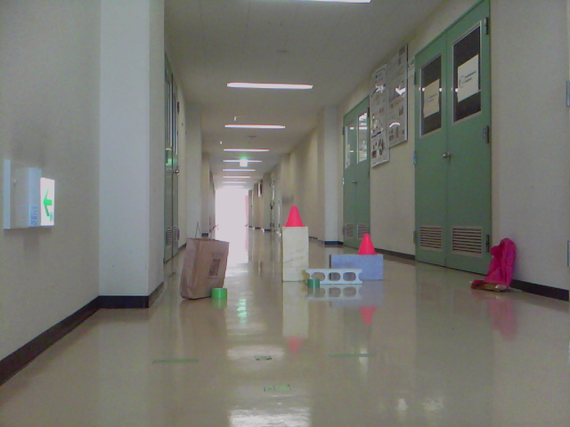
Landmark Extraction
Real-world images often contain stand-out regions
These interest regions can be exploited as landmarks
Notes:
Also assume that this robot wanders an environment populated with stationary objects that are easy to recognize, and can be taken as landmarks.

Slide 7
Landmark Changes
Images can be compared in terms of quantitative changes to landmark sightings
L1 = (w1, h1, u1, v1)
L2 = (w2, h2, u2, v2)
L2
L3 = (w3, h3, u3, v3)
L3
L4
L4 = (w4, h4, u4, v4)
(u1, v1)
L1
h1
w1
Notes:
Also assume that this robot wanders an environment populated with stationary objects that are easy to recognize, and can be taken as landmarks.

Slide 8
Landmark Changes
Images can be compared in terms of quantitative changes to landmark sightings
L'1 = (w'1, h'1, u'1, v'1)
L'2 = (w'2, h'2, u'2, v'2)
L2
L'3 = (w3, h3, u3, v3)
L3
L4
L'4 = (w4, h4, u4, v4)
(u1, v1)
L1
h1
w1
Notes:
Also assume that this robot wanders an environment populated with stationary objects that are easy to recognize, and can be taken as landmarks.

Slide 9
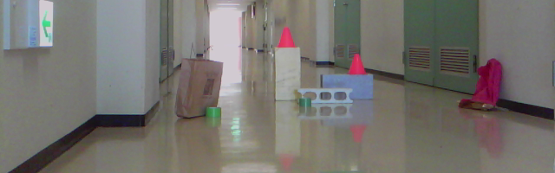
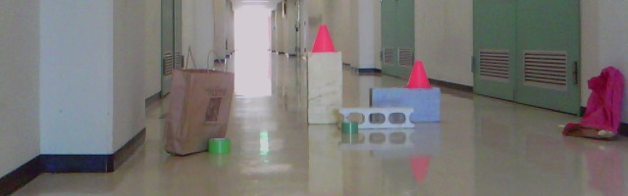
Landmark Changes
Images can be compared in terms of quantitative changes to landmark sightings
L2
L3
L4
L1
C1 = (Δw1, Δh1, Δu1, Δv1)
C2 = (Δw2, Δh2, Δu2, Δv2)
C1
C2
C3
C4
C3 = (Δw3, Δh3, Δu3, Δv3)
L'2
C4 = (Δw4, Δh4, Δu4, Δv4)
L'3
L'4
L'1
Notes:
Also assume that this robot wanders an environment populated with stationary objects that are easy to recognize, and can be taken as landmarks.

Slide 10
Displacement Estimation Model
Locate landmarks in picture
Notes:
First we locate the landmarks in a image.

Slide 11
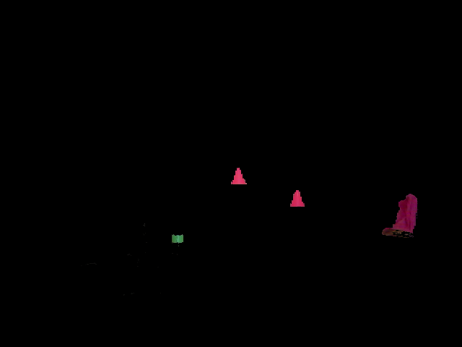
Displacement Estimation Model
Separate landmarks from background
Notes:
Next we separate them from the background.

Slide 12

Displacement Estimation Model
Tag landmark images with image-centric size and position data
L2
(w, h, u, v)
L3
(w, h, u, v)
L4
(w, h, u, v)
L1
(w, h, u, v)
Notes:
We then tag landmarks with their attributes,

Slide 13
Displacement Estimation Model
Create a scene as a collection of tagged landmarks
si
L2
(w, h, u, v)
L3
(w, h, u, v)
L4
(w, h, u, v)
L1
(w, h, u, v)
Notes:
And collect them in a new object called a scene.

Slide 14
Displacement Estimation Model
Associate the robot's coordinates at the time the original picture was taken to the scene as its position
si
pi = (xi, yi, θi)
L2
(w, h, u, v)
L3
(w, h, u, v)
L4
(w, h, u, v)
L1
(w, h, u, v)
Notes:
Finally we add to the object the location at which the original picture was taken, in global coordinates.

Slide 15
Changes to Images
As robot moves about, images of landmarks change
Change patterns depend on the mode of movement from one picture to the next
  Straight
  Sideways
  Turning
Notes:
Clearly, as the robot moves, landmark images change.
If we restrict ourselves to straight, sideways and turning movements, we can observe that characteristic change patterns are associated to each one of those movement modes.

Slide 16
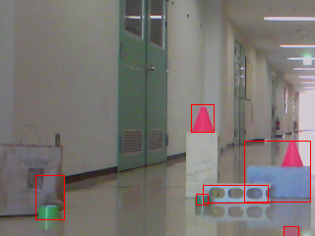
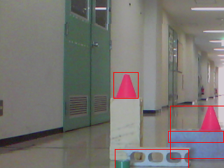
Changes to Images
Straight (forward) movement
  Landmarks appear bigger as they get close
Notes:
First, for straight movements, if the robot moves forward, landmarks seem to get bigger as they draw close (obviously the inverse would be true for backward movements).

Slide 17
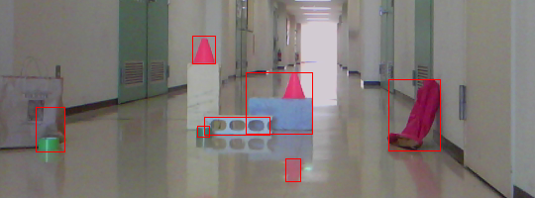
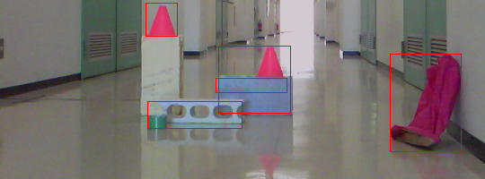
Changes to Images
Straight (forward) movement
  Landmarks drift towards image borders
Notes:
Landmarks also seem to drift apart, toward the image borders, as they are passed by.

Slide 18
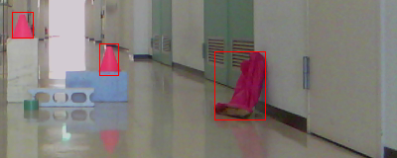
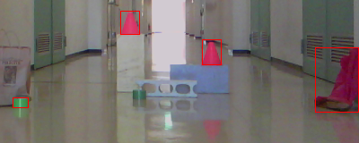
Changes to Images
Turning movements
  Landmarks slide horizontally across the image
  Size and relative position remain largely the same
Notes:
Whereas for turning movements, landmarks seem to slide horizontally in the inverse direction of the robot's movement (so if the robot turns left, landmarks seem to slide right), but sizes don't seem to change.

Slide 19
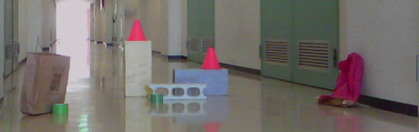
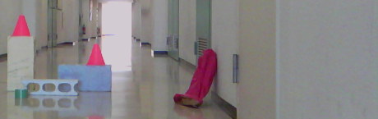
Changes to Images
Sideways movements
  Landmarks slide horizontally across the image
  Size and relative position remain largely the same
  Overlapping objects move relative to each other
Notes:
Sideways movements also experience the "sliding" effect found in turning movements, but there is also a marked parallax effect, as landmarks that are in front of one another seem to change position among themselves.

Slide 20
Displacement Estimation Model
Landmark sightings, and the changes they incur between robot movements, can be represented as sets of four attributes:
  Width
  Height
  Horizontal position
  Vertical position
Changes can be absolute or relative
Notes:
From these observations we can derive a model for reasoning about landmark image changes in quantitative terms.
Landmark sightings (that is, images), as well as changes between them, can be characterized as a set of four attributes: width, height, horizontal position and vertical position of landmark images (notice these are attributes of the landmark images, not the actual physical landmarks themselves).
Changes in these attributes can be calculated in absolute and relative terms.

Slide 21
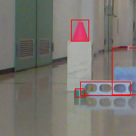
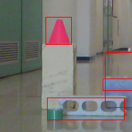
Displacement Estimation Model
Absolute: changes to same landmark across two images
(x1, y1, θ1)
(x2, y2, θ2)
(u1, v1)
(u2, v2)
h1
h2
w1
w2
Notes:
Absolute changes are calculated between two sightings of the same landmark.
So for example, if the robot moves forward, the sighting of a landmark will change across all four attributes, and these changes can be measured like this.
Notice that horizontal and vertical position changes are measured as a simple difference of successive values, but width and height changes are normalized by the smaller value.
This is because a certain amount of change to width or height will be more expressive for a small sighting than for a larger one. This normalization allows us to take that into consideration.

Slide 22
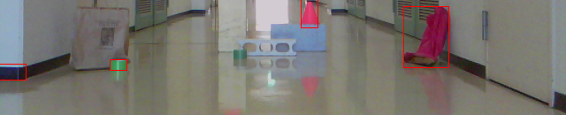
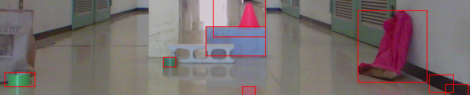
Displacement Estimation Model
Relative: changes to pair of landmarks across two images
(u'1, v'1)
(x1, y1, θ1)
(u1, v1)
h'1
h1
w1
w'1
(u'2, v'2)
(x2, y2, θ2)
h'2
(u2, v2)
h2
w'2
w2
Notes:
For relative changes, the relation between two landmarks is measured across two images.
For example, given these landmarks, we can see that their position relative to each other changes as the robot moves forward – they get farther away from each other.
This kind of change can be measured like this.
These formulas have two useful properties:
First, the absolute value is greater than one if the difference between landmarks increased from one image to the next, and smaller than one otherwise.
For example, as the distance between landmarks increase, the numerator here will be higher than the denominator. If the landmarks got closer, the inverse would be true.
Second, if the relation between two landmarks reverses, the value will be negative, and positive otherwise.
For example, this landmark is to the left of the other, so the difference in the numerator is negative. It has remained so in the next image, so the difference in the denominator is also negative, and therefore the change value is positive.
If the landmarks had exchanged relative positions – if this one got to the right of that one – the denominator difference would be positive, and the change value would become negative, signaling the inversion in the relation.

Slide 23
Displacement Estimation Model
Pictures can be described in terms of landmark sightings
Notes:
Just as a landmark sighting can be characterized as a set of attributes, a whole image can be characterized as a set of sightings.

Slide 24
Displacement Estimation Model
The difference between two scenes si and sj is the set of absolute and relative changes to their common landmarks
Dij
Si
Sj
Li1
-
Lj1
= (Δw, Δh, Δu, Δv)1
Li1
Li2
...
Liz
-
Lj1
Lj2
...
Ljz
=
Li2
-
Lj2
= (Δw, Δh, Δu, Δv)2
...
...
pi
pj
Liz
-
Ljz
= (Δw, Δh, Δu, Δv)z
Notes:
Now, given any two scenes constructed in this manner, the difference between them can be defined as the set of changes between their landmarks.

Slide 25
Displacement Estimation Model
The displacement is the change between their positions
Dij
Si
Sj
Li1
-
Lj1
= (Δw, Δh, Δu, Δv)1
Li1
Li2
...
Liz
-
Lj1
Lj2
...
Ljz
=
Li2
-
Lj2
= (Δw, Δh, Δu, Δv)2
...
...
pi
pj
Liz
-
Ljz
= (Δw, Δh, Δu, Δv)z
pi - pj = (Δx, Δy, Δθ)
Notes:
We can add to this representation the displacement between the positions of the two scenes.

Slide 26
Displacement Estimation Model
The mode is the form of movement (straight, sideways or turning) employed going from one position to the other
Dij
Si
Sj
Li1
-
Lj1
= (Δw, Δh, Δu, Δv)1
Li1
Li2
...
Liz
-
Lj1
Lj2
...
Ljz
=
Li2
-
Lj2
= (Δw, Δh, Δu, Δv)2
...
...
pi
pj
Liz
-
Ljz
= (Δw, Δh, Δu, Δv)z
pi - pj = (Δx, Δy, Δθ)
(St|Tn|Sy)
Notes:
And also which mode of movement (straight, turning or sideways) was used to go from one scene to the other.

Slide 27
Displacement Estimation Model
Given a difference between a reference scene si for which pi is known, and a query scene sj, can pj be derived?
Dij
Si
Sj
Li1
-
Lj1
= (Δw, Δh, Δu, Δv)1
Li1
Li2
...
Liz
-
Lj1
Lj2
...
Ljz
=
Li2
-
Lj2
= (Δw, Δh, Δu, Δv)2
...
...
pi
pj
pj ?
Liz
-
Ljz
= (Δw, Δh, Δu, Δv)z
pi - pj = (Δx, Δy, Δθ)
(F|T|S)
Notes:
This is the model for relating physical displacement to landmark image changes in quantitative terms.
Now the question is, given a reference scene for which position information is known, and a query scene for which position is not known, can we estimate the physical displacement between those two scenes, and therefore approximate the position of the query scene?

Slide 28
Statistical Analysis
Recorded data: 1300 images of test landmarks
Grid of 10 x 10 stops, 10cm apart
13 takes at each stop, 10° apart
Notes:
In order to verify whether it is possible, first we need a collection of images with known positions.
Using the Yamabiko robot I showed previously, 1300 images of a set of landmarks were recorded.
At each one of 100 equidistant stops in front of the landmarks, each 10cm apart, the robot took 13 pictures at different orientations, 10° apart.

Slide 29
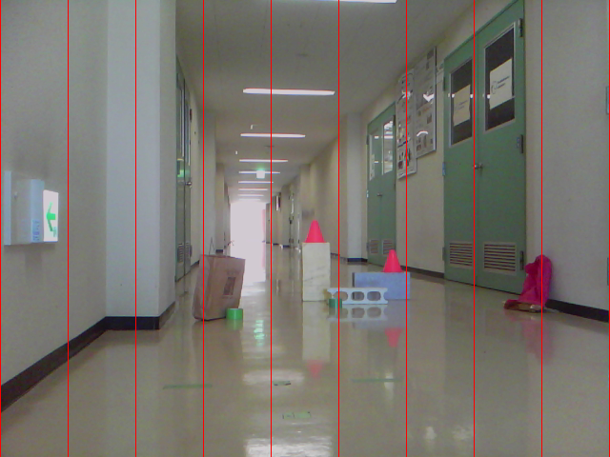
Statistical Analysis
Separate field of view in 9 vertical bands
Group sighting pairs by band of first sighting
Notes:
Sightings may change in different ways depending on where they originally stood in the picture. For example, during forward movements, landmarks may drift left, right or straight down.
Therefore, sighting pairs were grouped in 9 sets, depending on the position of the original sighting in the image. Each group was drawn in a separate plot.

Slide 30
Statistical Analysis
Displacement distance (dm) X average change (pixels)
1dm (= 10cm)
X avg(90 positions)
Notes:
Further, changes are averaged over displacement distance.
By this I mean, for example, for straight movements, all changes related to 10cm forward displacements are averaged and shown as a single data point.

Slide 31
Statistical Analysis
Displacement distance (dm) X average change (pixels)
1dm (= 10cm)
X avg(90 positions)
2dm (= 20cm)
X avg(80 positions)
Notes:
Likewise for 20cm forward displacements...

Slide 32
Statistical Analysis
Displacement distance (dm) X average change (pixels)
1dm (= 10cm)
X avg(90 positions)
2dm (= 20cm)
X avg(80 positions)
...
9dm (= 90cm)
X avg(10 positions)
Notes:
...and so on all the way to 90cm displacements. Data for sideways and turning movements are grouped by the same logic.

Slide 33
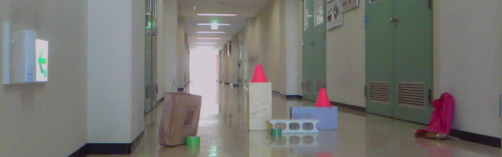
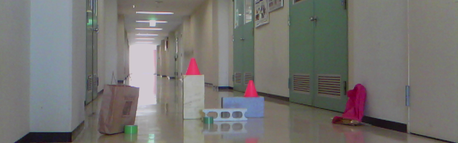
Statistical Analysis
Number of landmark pairs varies (due to occlusion etc)
10° turning (clockwise)
4 landmark pairs
Notes:
Not only there are less position pairs as distance increases, valid landmark pairs also get depleted. This is most visible in turning movements.
For example, if the robot turns 10 degrees to the right from this view, where these landmarks are visible...
...the leftmost landmark falls out of view. As a result we have just four landmark pairs from which to measure changes.

Slide 34
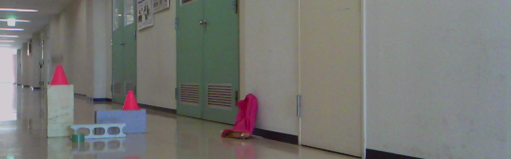
Statistical Analysis
Number of landmark pairs varies (due to occlusion etc)
40° turning (clockwise)
3 landmark pairs
Notes:
Turning 40 degrees from the same initial view, only three landmarks can be related between views.
So as distance between locations increase, not only we have less location pairs to study, there is also less common ground between those pairs from which to get useful information.

Slide 35
Statistical Analysis
Absolute changes
  Straight movements: 10cm increments forward
  Sideways movements: 10cm increments left-to-right
  Turning movements: 10° increments clockwise
Band-wise plots
Robot displacement (dm) X average change (pixels)
  Width
  Height
  Horizontal position (U)
  Vertical position (V)
Notes:
Next I'll show two sets of plots, one for absolute changes, the other for relative ones.
First, absolute changes. All three modes of movement are covered.
For each mode, I'll show separate plots for each change attribute, split by the nine image bands I just showed.
So without further ado...

Slide 36
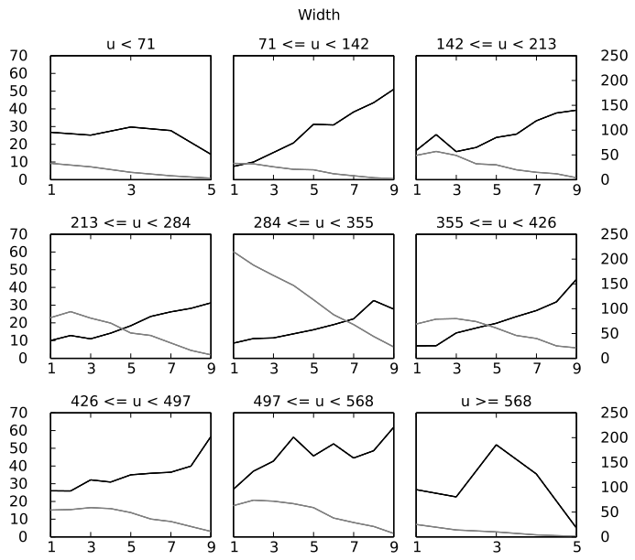
Statistical Analysis
Straight movements
Average change (pixels)
Number of landmark pairs
Displacement (dm)
Notes:
We can see the average absolute width change correlates well to straight movements, especially in the more central bands. Results tend to get erratic in bands closer to the borders, but that's to be expected, since there landmarks may fall out of sight from one image to the next.

Slide 37
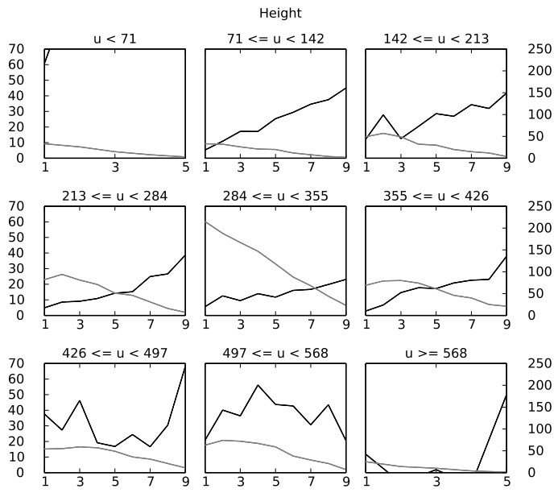
Statistical Analysis
Straight movements
Average change (pixels)
Number of landmark pairs
Displacement (dm)
Notes:
Height results are comparable...

Slide 38
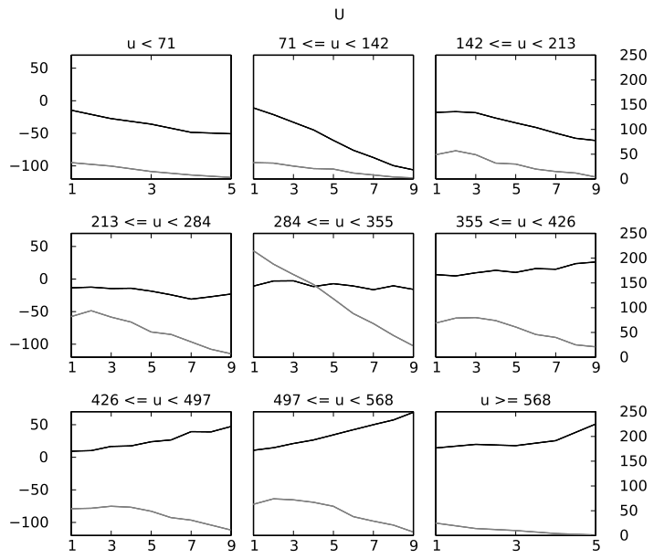
Statistical Analysis
Straight movements
Average change (pixels)
Number of landmark pairs
Displacement (dm)
Notes:
Horizontal position results confirm that landmarks first seen on the left or right bands tend to drift towards the respective border, while those at the center band tend to not drift horizontally at all.

Slide 39
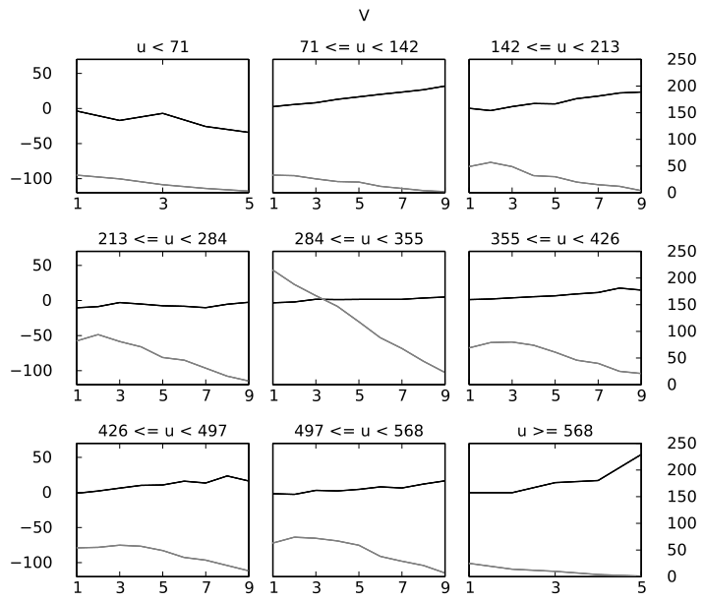
Statistical Analysis
Straight movements
Average change (pixels)
Number of landmark pairs
Displacement (dm)
Notes:
Vertical position was a bit surprising, as it only shows upward movements on average. This is likely an artifact of the way samples are split across vertical bands, causing downward movement instances to be offset by upward ones.

Slide 40
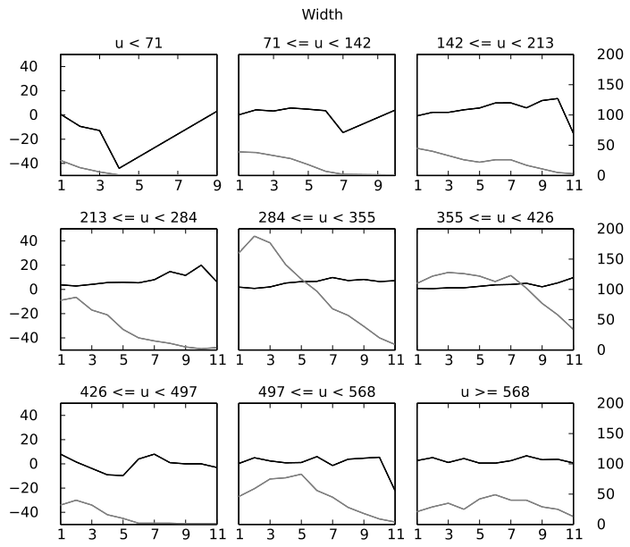
Statistical Analysis
Sideways movements
Average change (pixels)
Number of landmark pairs
Displacement (dm)
Notes:
For sideways movements, changes to width...

Slide 41
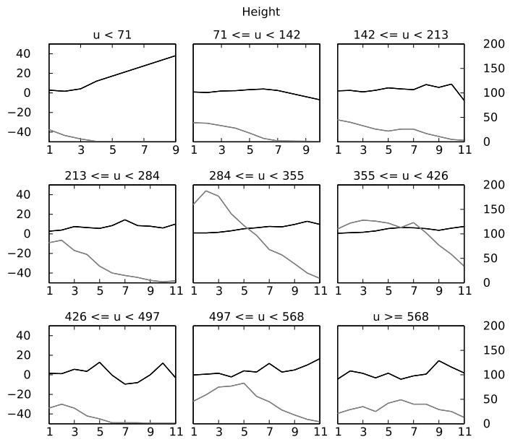
Statistical Analysis
Sideways movements
Average change (pixels)
Number of landmark pairs
Displacement (dm)
Notes:
...and height are negligible...

Slide 42
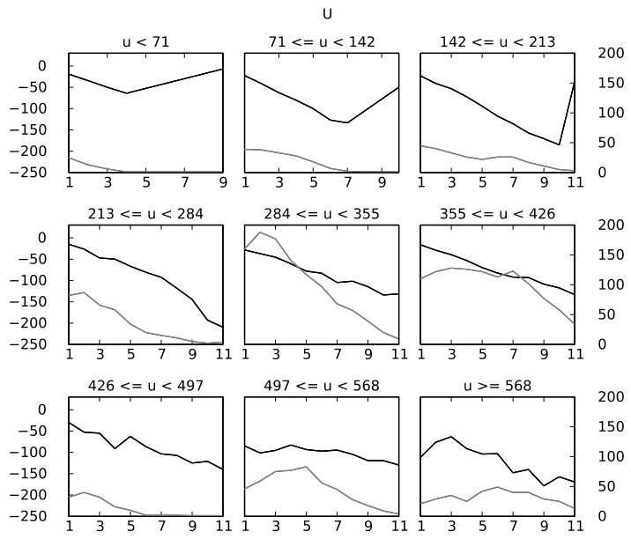
Statistical Analysis
Sideways movements
Average change (pixels)
Number of landmark pairs
Displacement (dm)
Notes:
...while changes to horizontal position correlate well to displacement...

Slide 43
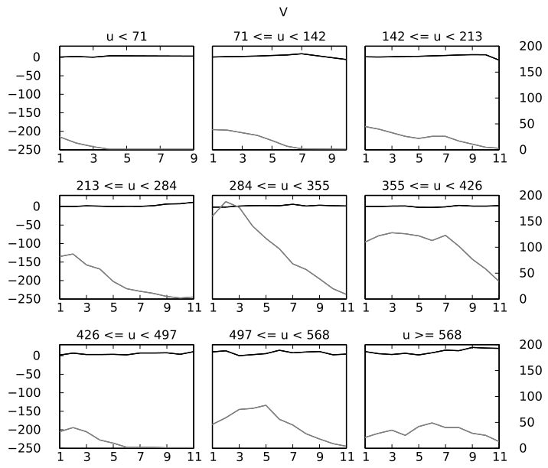
Statistical Analysis
Sideways movements
Average change (pixels)
Number of landmark pairs
Displacement (dm)
Notes:
…and changes to vertical position again can be all but disregarded.

Slide 44
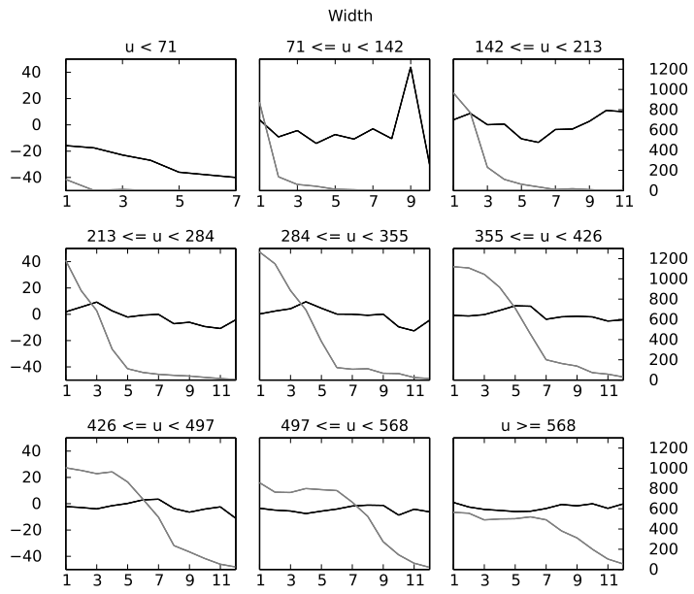
Statistical Analysis
Turning movements
Average change (pixels)
Number of landmark pairs
Displacement (x 10°)
Notes:
Turning movements show much the same results as sideways, with no relevant changes to width...

Slide 45
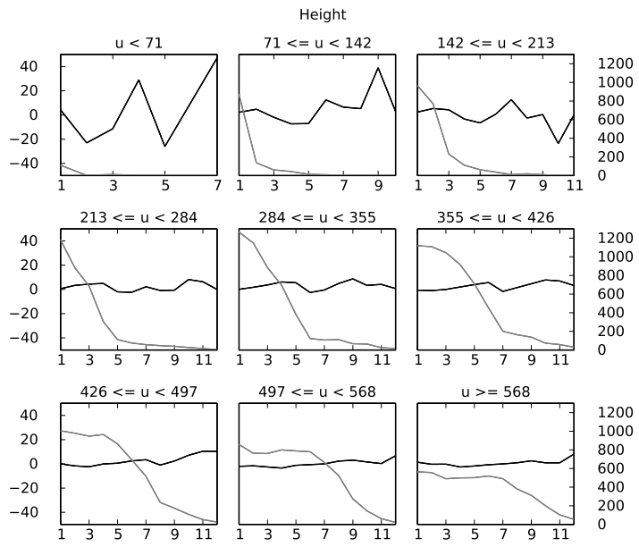
Statistical Analysis
Turning movements
Average change (pixels)
Number of landmark pairs
Displacement (x 10°)
Notes:
...or height...

Slide 46
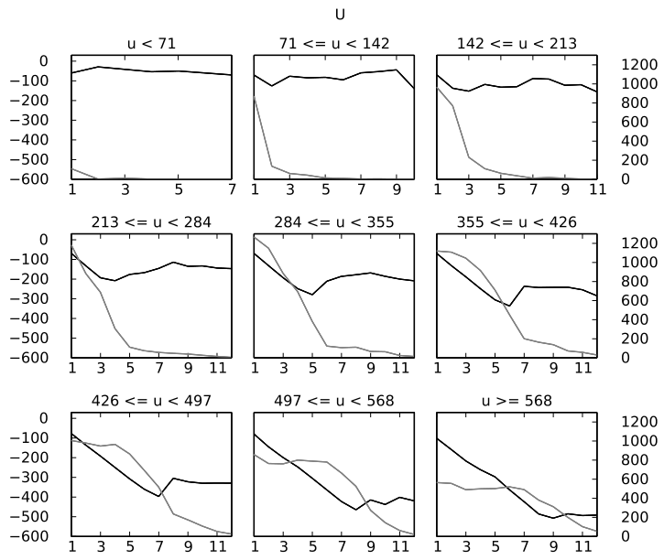
Statistical Analysis
Turning movements
Average change (pixels)
Number of landmark pairs
Displacement (x 10°)
Notes:
...good correlation across horizontal position...

Slide 47
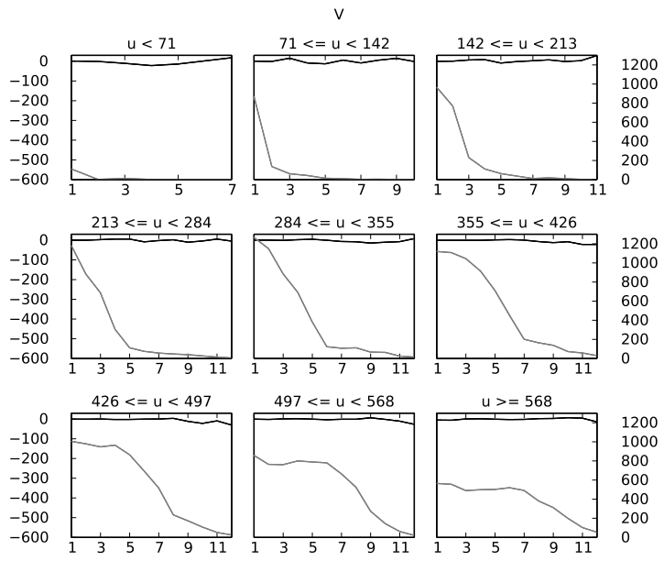
Statistical Analysis
Turning movements
Average change (pixels)
Number of landmark pairs
Displacement (x 10°)
Notes:
...and again negligible change at vertical position.

Slide 48
Statistical Analysis
Relative changes
  Turning movements: 10° increments clockwise
  Sideways movements: 10cm increments left-to-right
Robot displacement (dm) X average change (pixels)
  Horizontal position (U)
Notes:
As we saw, for each movement mode there is at least one sighting attribute whose absolute changes correlate well to it.
Also the fact that sighting dimensions change for straight movements but not for other modes makes it easy to tell this mode apart from the others.
But telling apart sideways and turning movements on absolute changes alone is not as easy. Therefore we turn to relative changes.
For relative changes I'll only show the horizontal position change plots, and only for sideways and turning movements. Also, since in this case relations between different landmarks in the same picture are taken, it makes little sense to split the data across bands.

Slide 49
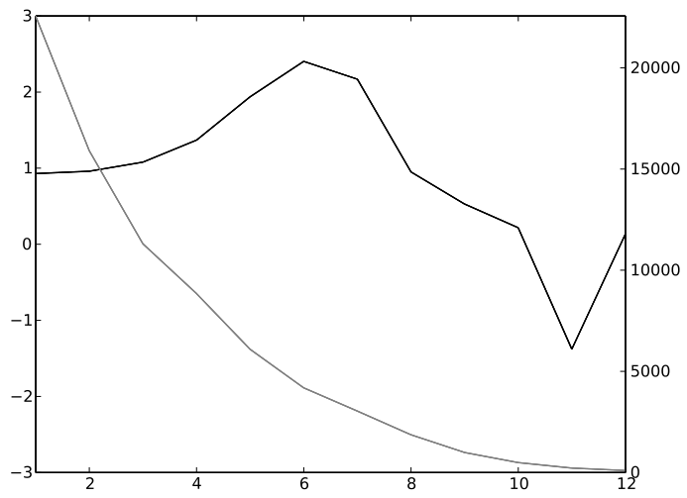
Statistical Analysis
Turning movements
Average change (pixels)
Number of landmark pairs
Displacement (x 10°)
Notes:
For turning movements, relative difference in horizontal positions increase steadily, until too many landmarks are occluded and results start to lose reliability.

Slide 50
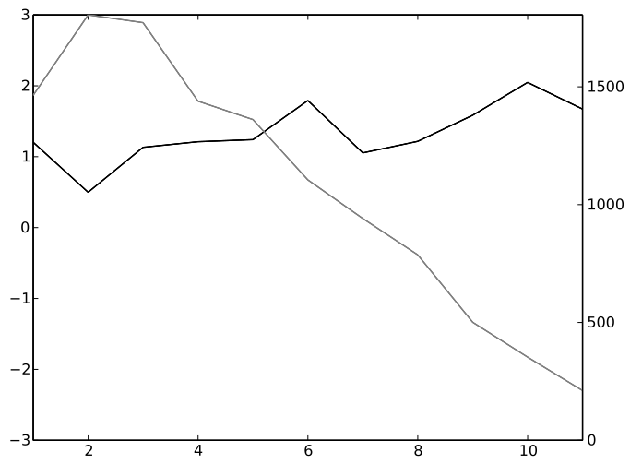
Statistical Analysis
Sideways movements
Average change (pixels)
Number of landmark pairs
Displacement (x 10°)
Notes:
Whereas for sideways movements, horizontal distance oscillates as the parallax effect makes landmarks slide past each other.
Given these two distinct profiles, relative changes

Slide 51
Conclusions
Sighting dimensions (width, height) and horizontal positions correlate well to straight movements
Sighting horizontal positions correlate well to sideways and turning movements
Differences in relative changes can be exploited to tell apart sideways and turning movements
The feasibility of estimating robot displacement from landmark sighting changes is not to be ruled out

Slide 52
Further Research
Methods for selecting landmarks
Larger / more varied image data base
Apply machine learning methods (e.g. WNN)
Application: visual navigation
Notes:
From now on, what I intend to look into are
better ways to select and compare landmarks,
Increase the size and diversity of the image data base,
And experiment with machine-learning methods to actually estimate individual physical displacements from landmark changes.
Ultimately I expect to be able to apply these principles to a visual navigation system.

Slide 53
The End
Source code, data files and article contents available at: http://github.com/xperroni/Yamabiko/tree/master/2013-3
Questions?
Notes:
This is the end of my presentation. By the way all files and source code of the programs used in this research are available at this URL.
Do you have any questions?

